Slide 1

Parallel Adder and Accumulator in Verilog
Ryan Thompson
Texas State University
EE4321.001

Slide 2
Critical Design Decisions
Complete abandonment of arrays for variable part select and direct addressing found in IEEE Std 1800-2012 § 11.5.1
Simple and fast, but tedious
Analysis isn’t difficult thanks to hex representation (every 4 bits represents an element)
Non-scalable approach because of prioritization of how well the design runs with the given specifications
Two 256bit inputs regardless of operation (4x4x16bit matrix representation)
One 512bit output (dual matrix representation) to handle matrix and scalar multiplication
Without output offset

Slide 3
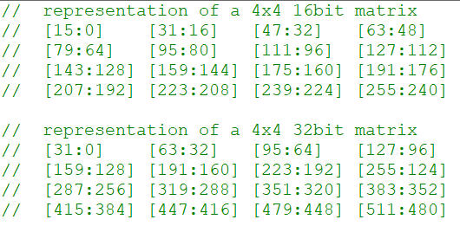
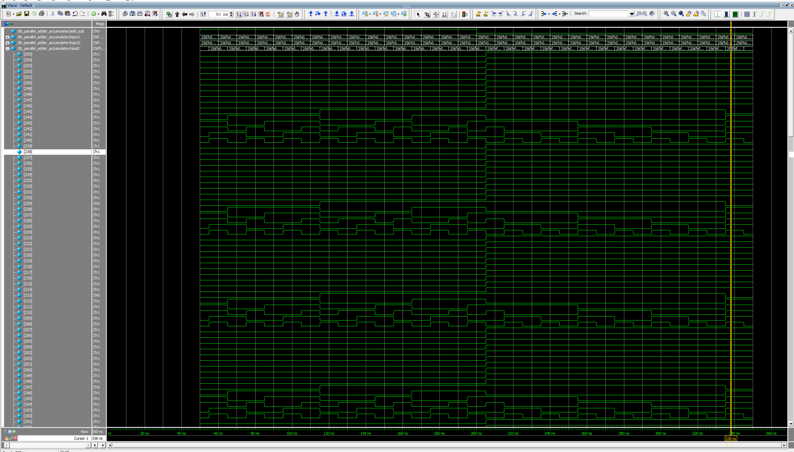
Adder/Subtractor
Took the longest because of not knowing how to approach the matrix representation dilemma. One day I’ll be able to switch .v to .sv and wipe all my problems away
Unlike the other modules, there’s a mode switch for either addition or subtraction (a ± b)

Slide 4
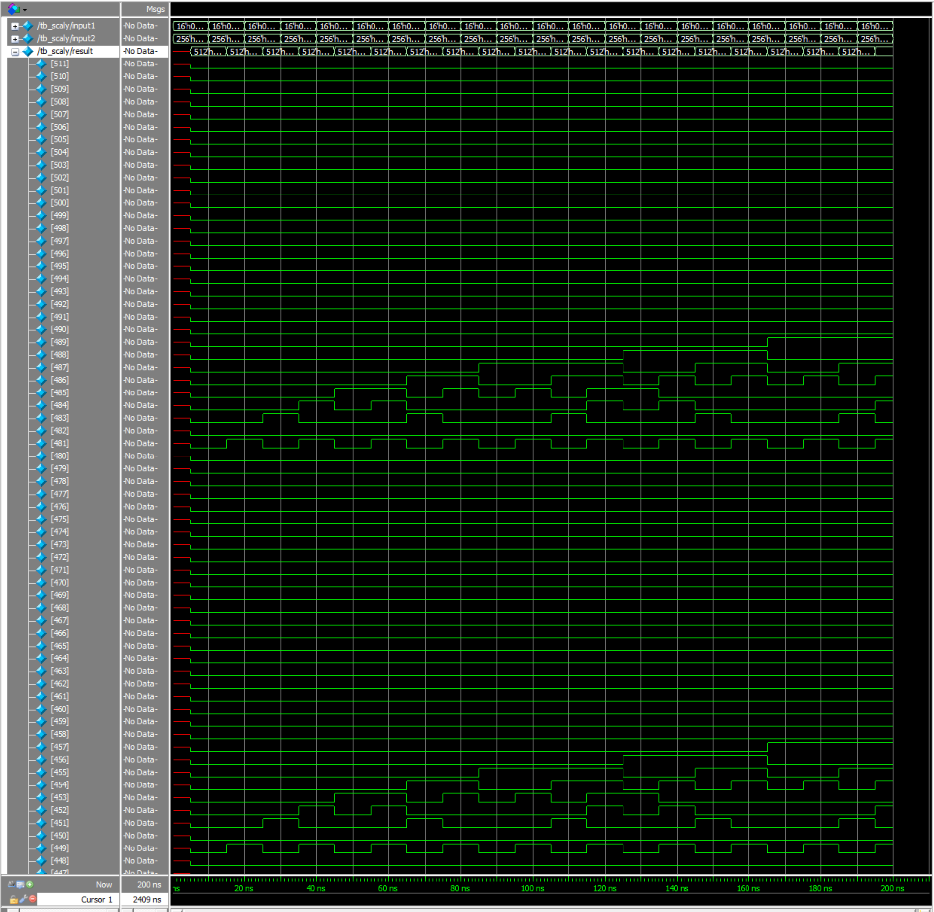
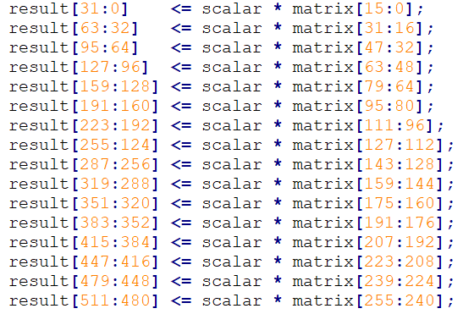
Scalar
Took the input1’s first 16 bits as the scalar to multiply against input2’s matrix
Simply multiplied each element in parallel by the scalar quantity

Slide 5
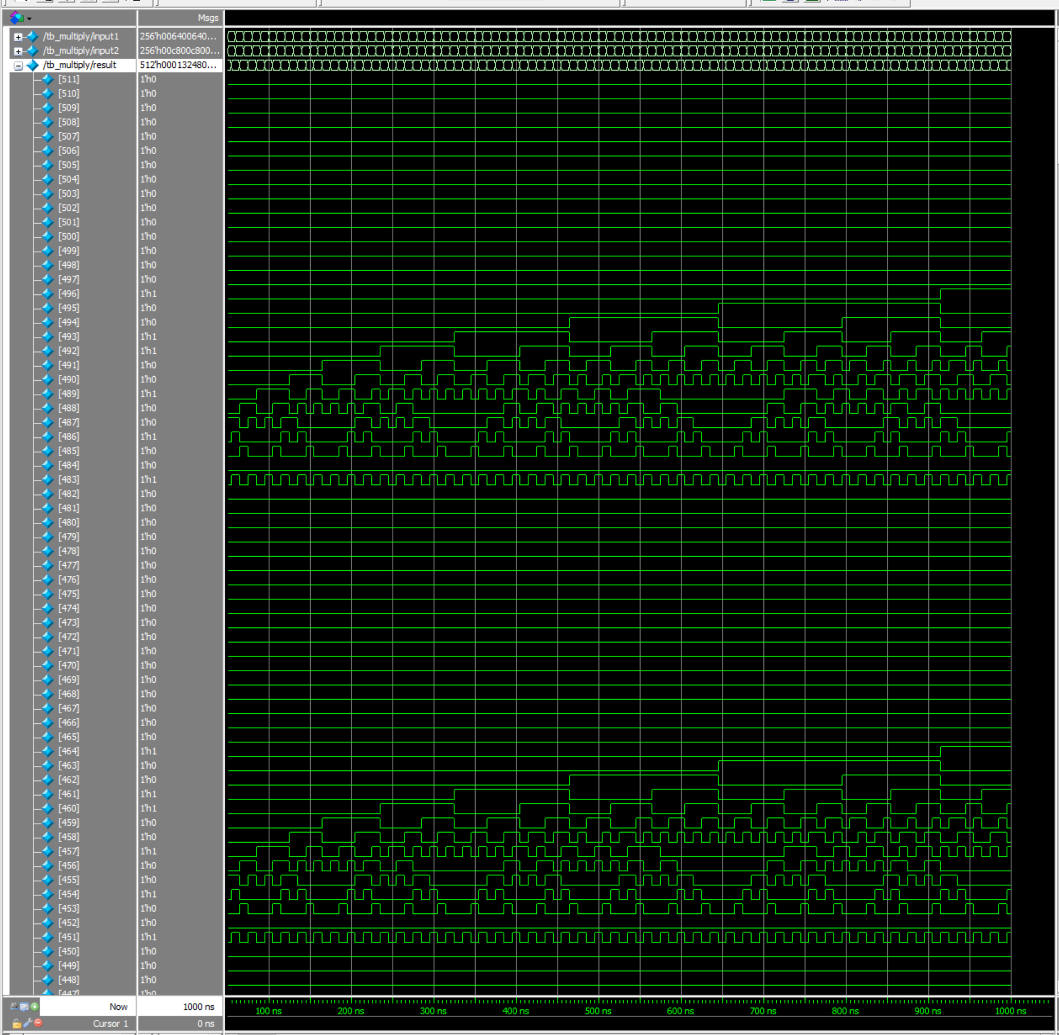
Multiplier
Tedious, but surely did not take the most time
Turning point in regard to finalizing every module’s output’s memory usage at 512 bits
Kind of following the MIPS one-size-fits-all instruction set
More memory up front, less computation
Completed by manually working out the matrix multiply
Ran in parallel like scalar multiplication, but with the
appropriate differences
This method is fast, but not scalable by any means
16 sequential operations ran in parallel

Slide 6
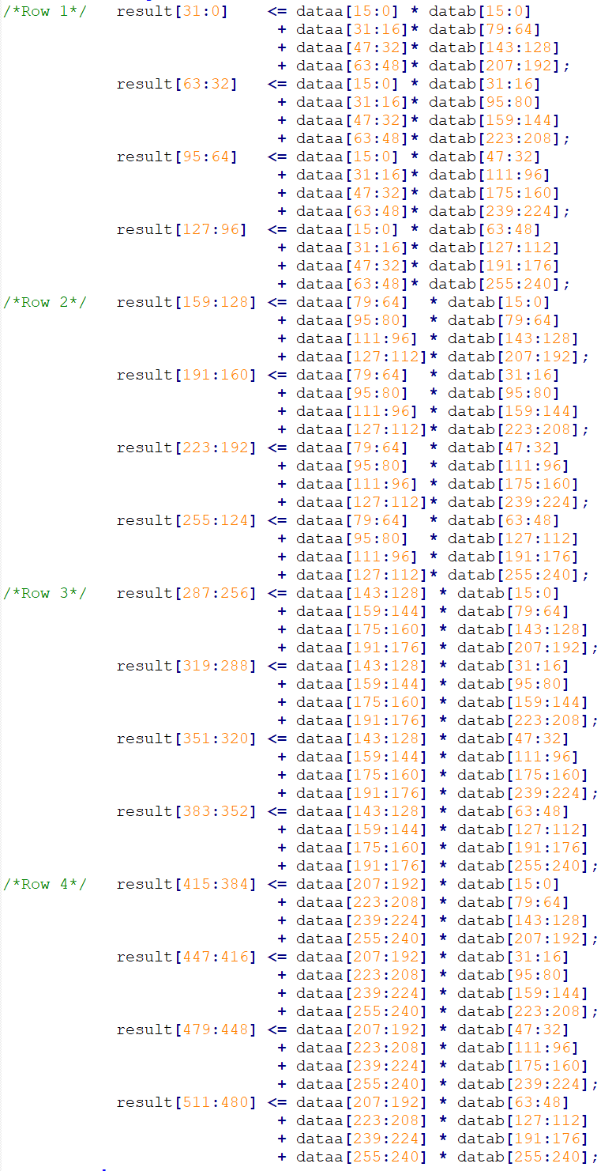
Looks like someone forgot how to use for loops

Slide 7
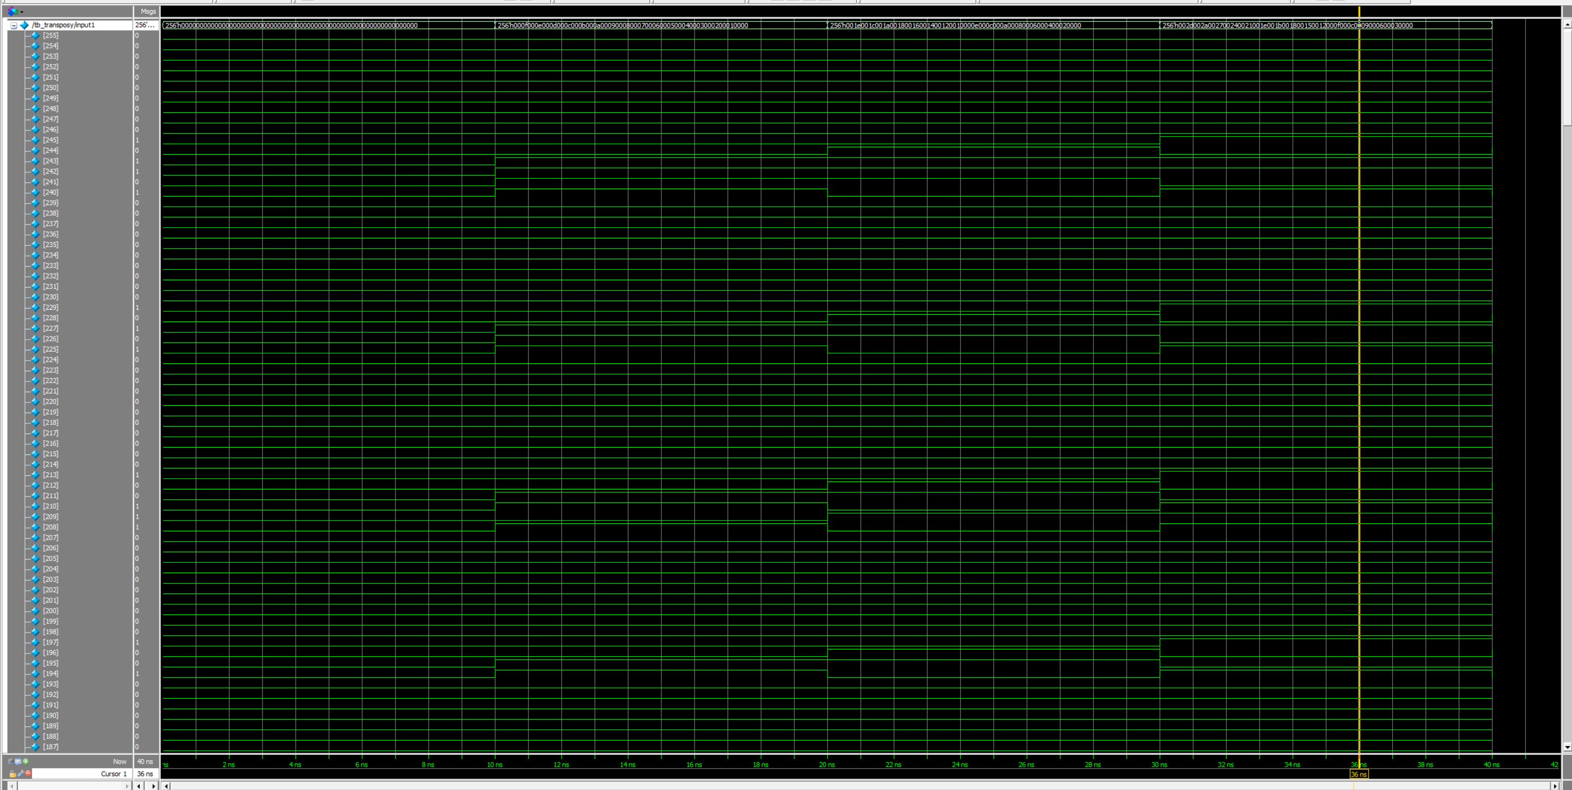
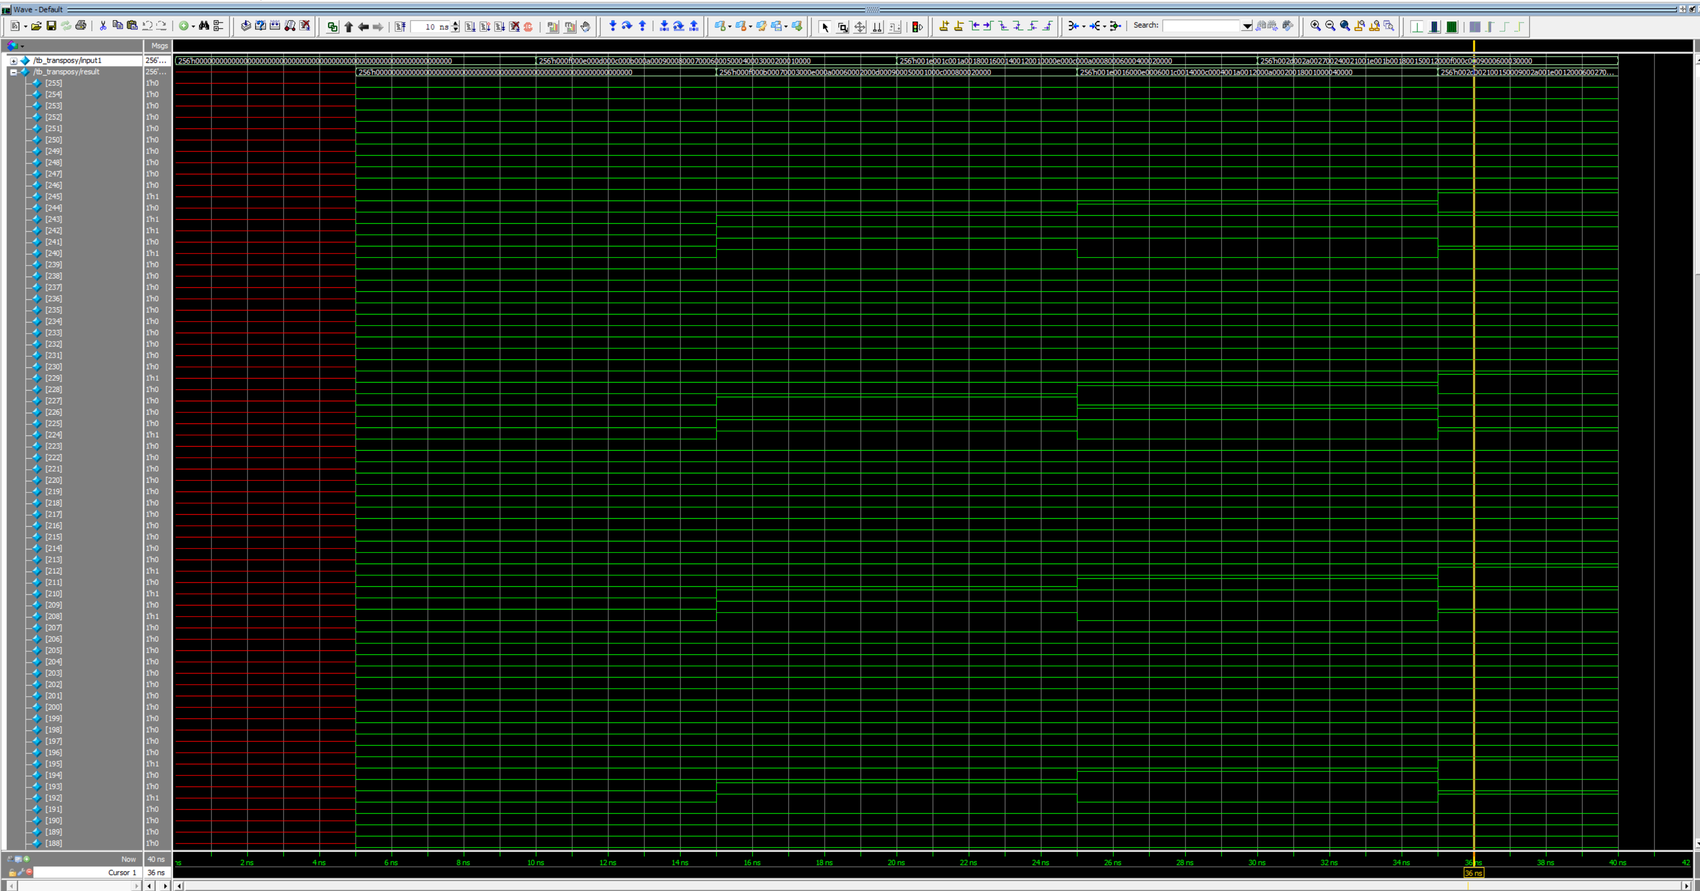
Transpose
Fastest one to do
Since matrix is fixed, just run 16 assignment operations in parallel that follow the rules for transposing a 4x4 matrix

Slide 8
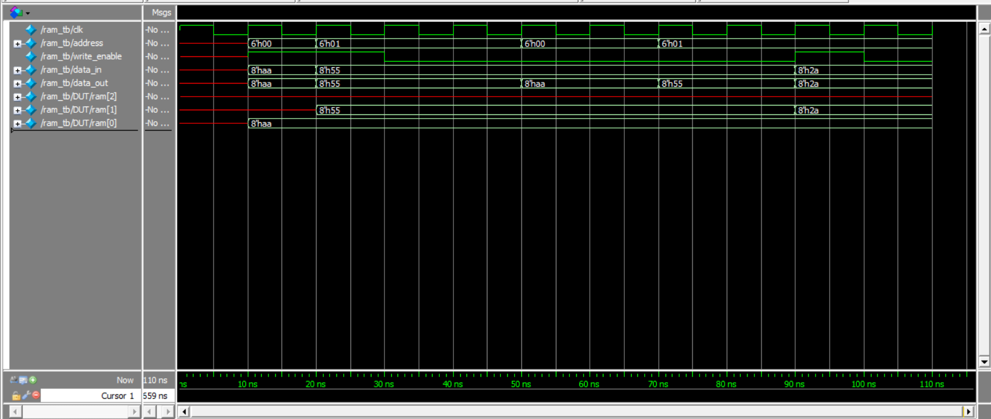
Random Access Memory
The biggest challenge here was figuring out how Verilog interacts with RAM, but it ended up being a module with registers dedicated to storage.
It’s somewhat misleading since the address isn’t randomly obtained from an opcode. It turns out the test bench itself is the opcode
The design I went with was a single-port design to avoid unnecessary complexity for the application
6bit address space allowing 64 elements to be addressed
64 elements x 512bit elements = 4KB

Slide 9
Select
There were a few choices to handle which module was going to be actioned
Not chosen, but probably better in the long run: Select module that sends a enable signal to the appropriate modules.
Wastes an initial clock cycle and adds to the pipeline
Chosen way: Assign a select enable value for each module and assign the select pins from the testbench (opcode). This way the variables are wired to each module, but only one will receive the special key allowing for that module to change the output register’s value
Add/sub = 00
Scale Multiply = 01
Multipy = 10
Transpose = 11

Slide 10
Design Decision Dilemmas
Mealy-ability
If every element was represented with 32bits, it would be easy to reuse results from any operation
The problem starts with where do you want to stop? When 32bit matrices are multiplied, now you have 64bit element matrices you must store and cannot reuse if over a 32bit representation
Partial Mealy-ability
The model chosen is a compromise where Transpose, Addition, and subtraction function outputs can be reused as inputs. Addition and subtraction still has the off chance of overflow, but it’s the same limitation as c++ that everyone deals with.

Slide 11
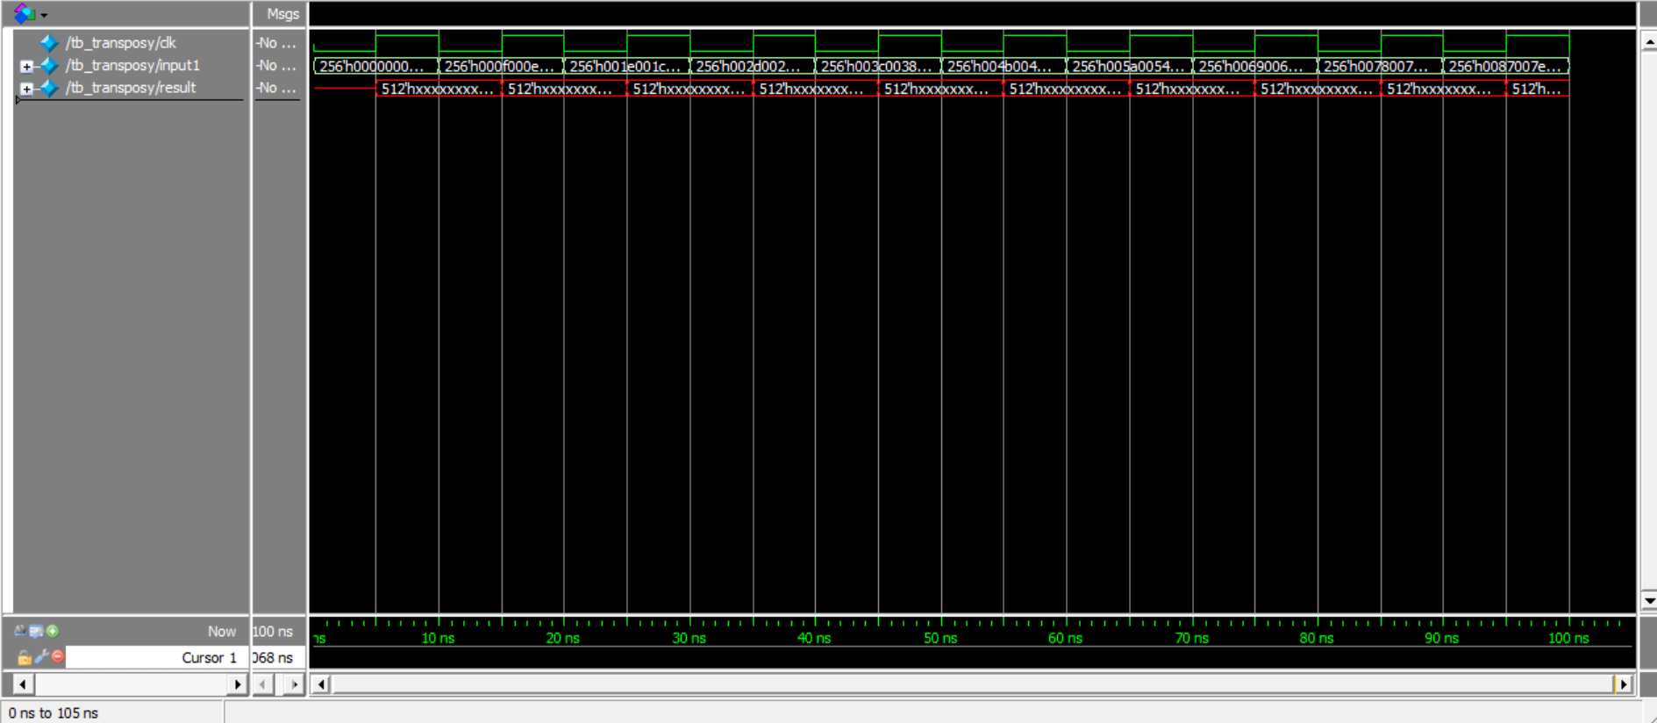
Stability
50% Duty cycle offset
When the input1 and input2 change at the falling edge of the clock signal, the data output latches the results 5ns later (in this case where the period is 10ns)
All this really does is eliminate any ignorance over not knowing the room for error on FPGAs

